Slide 2
2.1 Declaring beans
package com.springinaction.springidol;
public interface Performer {
void perform() throws PerformanceException;
}

Slide 3
2.1.1 Setting up Spring configuration
<?xml version="1.0" encoding="UTF-8"?>
<beans xmlns="http://www.springframework.org/schema/beans"
xmlns:xsi="http://www.w3.org/2001/XMLSchema-instance"
xsi:schemaLocation="http://www.springframework.org/schema/beans
http://www.springframework.org/schema/beans/spring-beans-3.0.xsd">
<!-- Bean declarations go here -->
</beans>
Core primitive namespace: enable to declare and connect beans

Slide 4
2.1.2 Declaring a simple bean
package com.springinaction.springidol;
public class Juggler implements Performer {
private int beanBags = 3;
public Juggler() {
}
public Juggler(int beanBags) {
this.beanBags = beanBags;
}
public void perform() throws PerformanceException {
System.out.println("JUGGLING " + beanBags + " BEANBAGS");
}
}

Slide 5
2.1.2 Declaring a simple bean
Declare an instance (Duke) in the Spring configuration file (spring-idol.xml):
<bean id="duke"
class="com.springinaction.springidol.Juggler" />
Bean’s name
Bean’s class
Most basic configuration unit in Spring
In essence, Duke will be created using the following Java code:
new com.springinaction.springidol.Juggler();

Slide 6
2.1.2 Declaring a simple bean
We can load the Spring application context using the following
code:
ApplicationContext ctx = new ClassPathXmlApplicationContext(
"com/springinaction/springidol/spring-idol.xml");
Performer performer = (Performer) ctx.getBean("duke");
performer.perform();
>> JUGGLING 3 BEANBAGS

Slide 7
2.1.3 Injecting through constructors
Juggler class can be constructed in two different
ways:
- Using the default constructor.
- Using a constructor that takes an int argument which indicates the number of beanbags that the Juggler will attempt to keep in the air.

Slide 8
2.1.3 Injecting through constructors
To make Duke a world-record juggler, we’ll need to use the other constructor. The following XML redeclares Duke as a 15 - beanbag juggler:
<bean id="duke"
class="com.springinaction.springidol.Juggler">
<constructor-arg value="15" />
</bean>
If no <constructor-arg>s are given, as in section 2.1.2, the default constructor is used.

Slide 9
2.1.3 Injecting through constructors
>> JUGGLING 15 BEANBAGS

Slide 10
2.1.3.1 Injecting object references with constructors
Assume Duke is a poetic juggler so PoeticJuggler is a class more descriptive of Duke’s talent.

Slide 11
2.1.3.1 Injecting object references with constructors
Inject
package com.springinaction.springidol;
public class PoeticJuggler extends Juggler {
private Poem poem;
public PoeticJuggler(Poem poem) {
super();
this.poem = poem;
}
…
}
public PoeticJuggler(int beanBags, Poem poem) {
super(beanBags);
this.poem = poem;
}
public void perform() throws PerformanceException {
super.perform();
System.out.println("While reciting...");
poem.recite();
}
Inject

Slide 12
2.1.3.1 Injecting object references with constructors
Define poem interface:
package com.springinaction.springidol;
public interface Poem {
void recite();
}

Slide 13
2.1.3.1 Injecting object references with constructors
package com.springinaction.springidol;
public class Sonnet29 implements Poem {
private static String[] LINES = {
"When, in disgrace with fortune and men's eyes,",
"I all alone beweep my outcast state",
…
}
public Sonnet29() { }
public void recite() {
for (int i = 0; i < LINES.length; i++) {
System.out.println(LINES[i]);
}
}
}

Slide 14
2.1.3.1 Injecting object references with constructors
Sonnet29 can be declared as a Spring <bean> with the following XML. With the poem chosen, all you need to do is give it to Duke. Now that Duke is a PoeticJuggler, his <bean> declaration will need to change slightly:
<bean id="sonnet29"
class="com.springinaction.springidol.Sonnet29" />
<bean id="poeticDuke"
class="com.springinaction.springidol.PoeticJuggler">
<constructor-arg value="15" />
<constructor-arg ref="sonnet29" />
</bean>
Value
Object
The value passed to the constructor should be a reference to the bean whose ID is sonnet29.

Slide 15
2.1.3.1 Injecting object references with constructors
Equivalent code:
Poem sonnet29 = new Sonnet29();
Performer duke = new PoeticJuggler(15, sonnet29);
>> JUGGLING 15 BEANBAGS WHILE RECITING... When, in disgrace with fortune and men's eyes, …

Slide 16
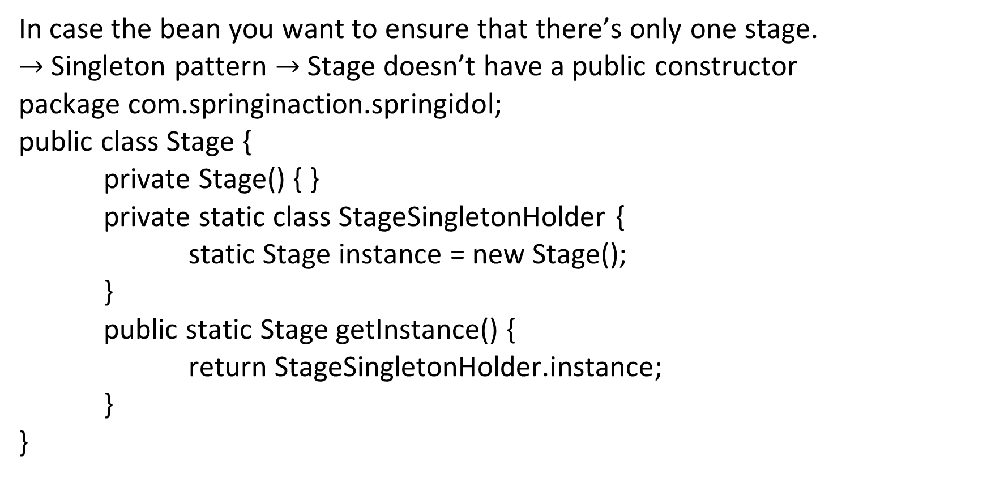
2.1.3.2 Creating beans through factory methods
In case the bean you want to ensure that there’s only one stage.
$→$ Singleton pattern $→$ Stage doesn’t have a public constructor
package com.springinaction.springidol;
public class Stage {
private Stage() { }
private static class StageSingletonHolder {
static Stage instance = new Stage();
}
public static Stage getInstance() {
return StageSingletonHolder.instance;
}
}

Slide 17
2.1.3.2 Creating beans through factory methods
<bean id="theStage"
class="com.springinaction.springidol.Stage"
factory-method="getInstance" />

Slide 18
2.1.4 Bean scoping
When declaring a <bean> in Spring, you have the option of declaring a scope for that bean.
<bean id="ticket"
class="com.springinaction.springidol.Ticket" scope="prototype" />
Singleton: Scopes the bean definition to a single instance per Spring container (default).
Prototype: Allows a bean to be instantiated any number of times (once per use).

Slide 19
2.1.5 Initializing and destroying beans
To define setup and teardown for a bean, simply declare the <bean> with init-method and/or destroy-method parameters.
To illustrate, imagine that we have a Java class called Auditorium which represents the performance hall where the talent competition will take place.

Slide 20
2.1.5 Initializing and destroying beans
public class Auditorium {
public void turnOnLights() {
...
}
public void turnOffLights() {
...
}
}
<bean id="auditorium"
class="com.springinaction.springidol.Auditorium"
init-method="turnOnLights"
destroy-method="turnOffLights"/>

Slide 21
2.1.5.1 Default init-method and destroy-method
<?xml version="1.0" encoding="UTF-8"?>
<beans xmlns="http://www.springframework.org/schema/beans"
xmlns:xsi="http://www.w3.org/2001/XMLSchema-instance"
xsi:schemaLocation="http://www.springframework.org/schema/beans
http://www.springframework.org/schema/beans/spring-beans-3.0.xsd"
default-init-method="turnOnLights"
default-destroy-method="turnOffLights"> ...
</beans>
In this case, we’re asking Spring to initialize all beans in the context definition file by calling turnOnLights() and to tear them down with turnOffLights()

